Slide 1
Debrief 18/04/23

Slide 2



Week 6: Prep for Mid-term Review
 | Monday 17 April | Tuesday 18 April | Wednesday 19 April | Thursday 20 April | Friday 21 April
10.00am to12.30pm | Corporate Project Meeting Project Sponsors 3 | Corporate Project | Job Readiness Workshop Micron Visit | Personal Growth TomoWork’s Got Talent | Digital Skills Learning
12.30pm to 2pm | Lunch Break | Lunch Break | Lunch Break | Lunch Break | Lunch Break
2pm to 4.30pm | Corporate Project | Corporate Project | Job Readiness Linkedin Clinic & Visit | Personal Growth TomoWork’s Got Talent | Digital Skills Learning
In-person session at
Republic Polytechnic
Work From Home (WFH)
Flexible arrangement
Company Visit

Slide 3
Programme for 19th April 2023 (Wednesday)
Time | Event | Venue
9am sharp | Woodland North MRT | Woodland North MRT
9.15am sharp | Board Bus (PA2626) to Micron F10A - https://goo.gl/maps/x7ahDDryJT6JFPLH7
10am | Micron Visit
12.15pm – 12.50pm | Lunch
1 pm | Bus together to S018983 | S018983
1.45pm | Linkedin Registration
2pm | Linkedin Visit
4.15pm – 4.30pm | Debrief
4.30pm | Dismissal
Things to Bring: IC or Singpass, Laptop with Charger, money for lunch, comb, writing materials and handphone.
Wear: Purple TomoWork Shirt, Long pants/Skirt, covered shoes

Slide 4
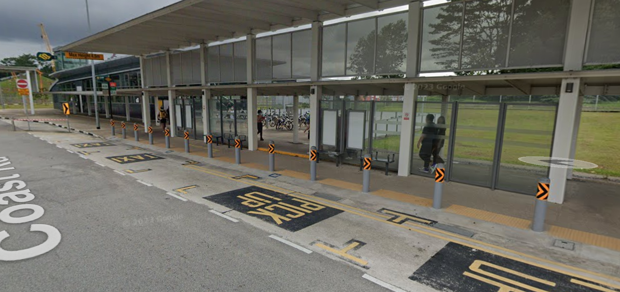
Meet here at 9am sharp: Woodlands North MRT Bus Bay

Slide 5
Don't
Do
Take pictures/videos without permission
Wander off from your group
Leave the group for the toilet without telling anyone
Ask questions without being called
Ask for permission before taking pictures/videos
Stay with your group at all times
Inform your team leader before going to the toilet (only go to the toilet if you really need to)
Raise your hand and wait to be called before asking questions

Slide 6
Don't
Do
Ask multiple questions that are irrelevant or insignificant
Interrupt the speaker
Touch things without permission
Ask a few important questions that are most helpful for you
Be polite to the speaker
Ask for permission if you want to touch something

Slide 7
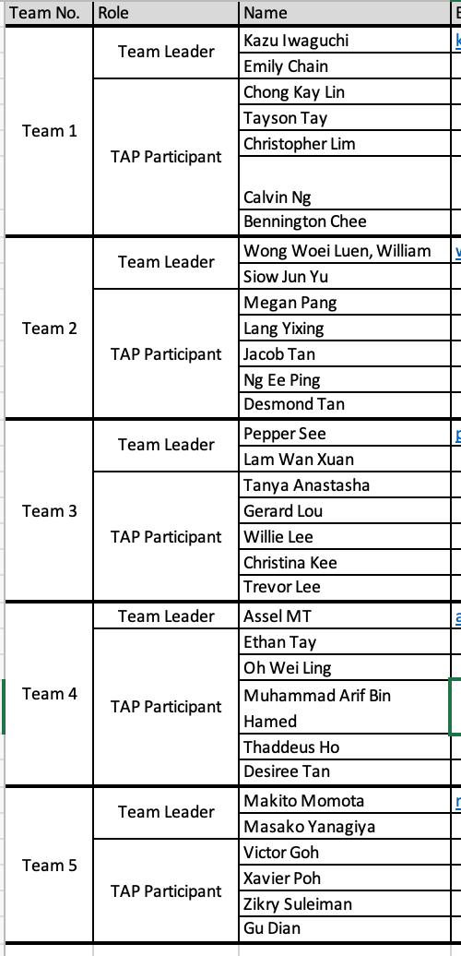
Micron Grouping

Slide 8
Linkedin Programme
Time | Programme
1.45pm | Registration
2pm- 2.10pm | Welcome
2.15 – 3pm | Presentation – LinkedIn 101 for Students
3pm – 3.30pm | Recruiter’s perspective – what do recruiters look out for in a candidate
3.30pm – 3.45pm | 15 mins break for students, Tomowork to brief LI employee coaches
3.45 – 430pm | Career Conversations
4.30pm – 4.45pm | Office Tour
Registration: You have received an email from LinkedInGuest with a unique QR code for registration. Please check your junk mail if you do not see it in your inbox.

Slide 9
Programme for 20th April 2023 (Thursday)
Time | Event | Venue
9.15am sharp | Republic Poly | TRCC Studio
9.30am sharp – 12pm | Rehearsal & Sound Check
12pm – 1pm | Lunch
1pm | Report to TRCC | TRCC Studio
1.30pm- 2.45pm | TomoWork’s Got Talent (Part 1)
2.45pm – 2.55pm | 10 min Break
3pm – 4pm | TomoWork’s Got Talent (Part 2)
4pm – 4.45pm | Group Photo + Debrief
4.45pm – 5pm | Pack and vacate
Things to Bring: Your outfit/props/instrument for TGT, Laptop with Charger(optional), money for lunch, comb, writing materials and handphone.
Read Full TGT Schedule: Week 6 > 19 April folder > 2023 TGT Programme (Please read).pdf
Wear: Performance Outfit

Slide 10
TomoWork's Got Talent Reminders
Every presentation will be stopped at 3 minutes
An ORANGE card will be held when you reach your last 30 seconds, please start to wrap up when the card is shown
A RED card will be held when your time is up, please stop your presentation when the card is shown.

Slide 11
